Slide 1

Introduction to Computer Interrupt Management
Professor : Jake Tarn
Lecturer: Sunny

Slide 2
Syncing tasks and ISR using semaphores

Slide 3
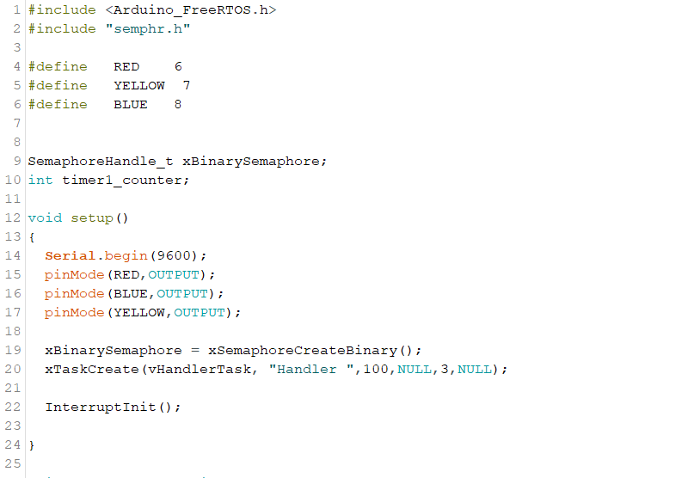

Slide 4
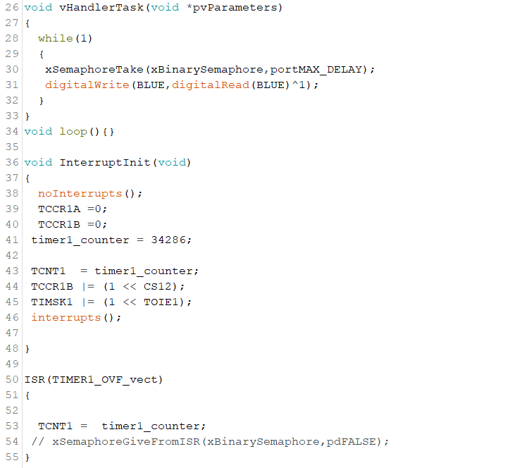

Slide 5
Queues and interrupts

Slide 6
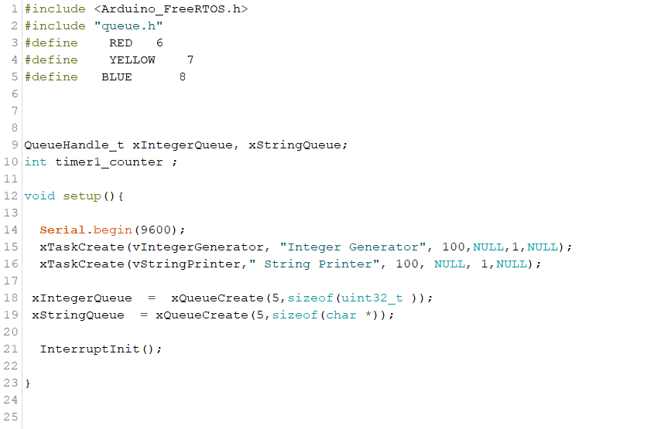

Slide 7
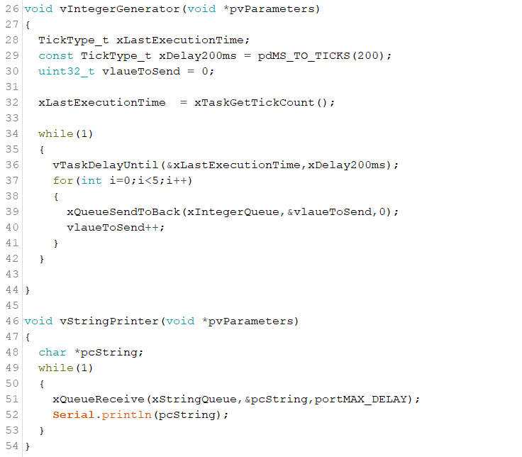

Slide 8
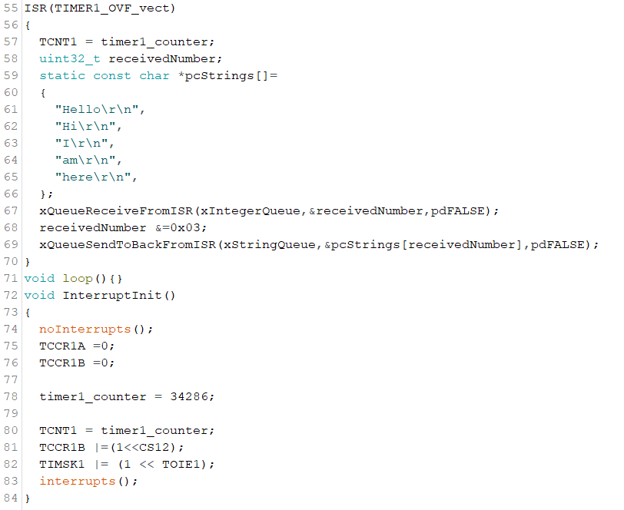

Slide 9
Non-Preemption

Slide 10
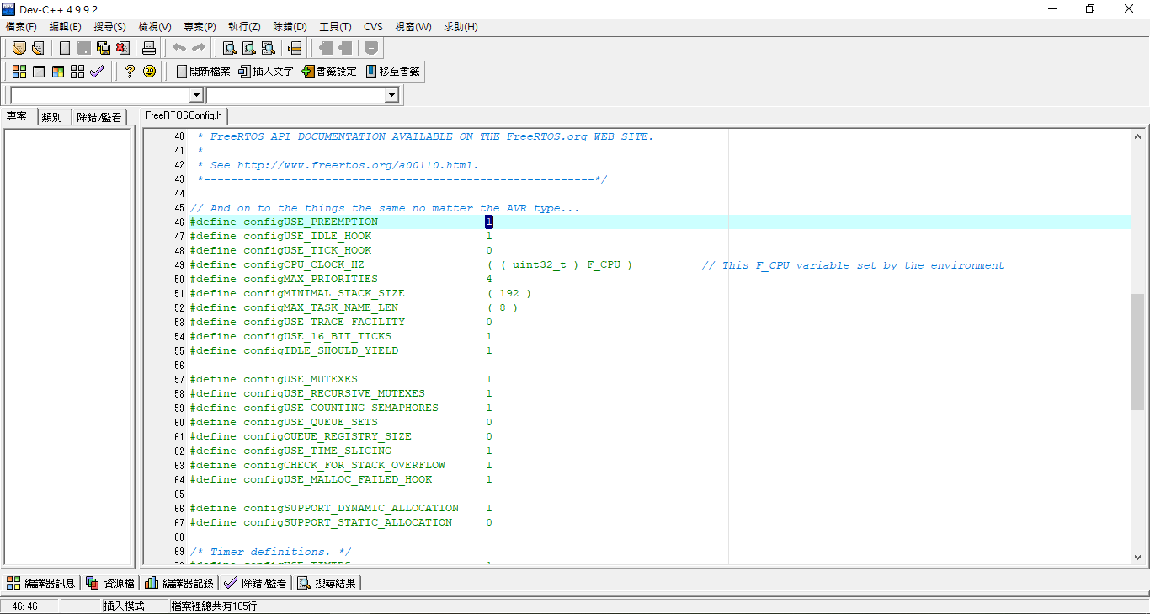

Slide 11
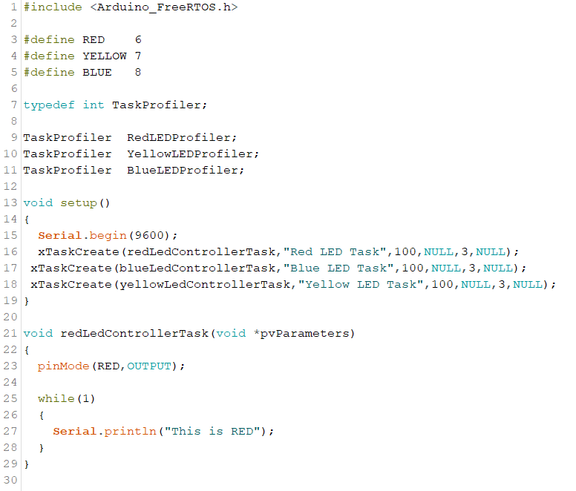

Slide 12
